Slide 1


Slide 2
Database Management Systems
Week 4, Day 4
MongoDB—Aggregate Functions
Atta Muhammad
+92-333-1971110
attapanhyar@quest.edu.pk

Slide 3
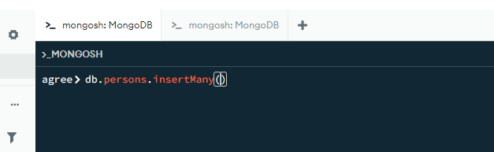
Loading sample Data

Slide 4
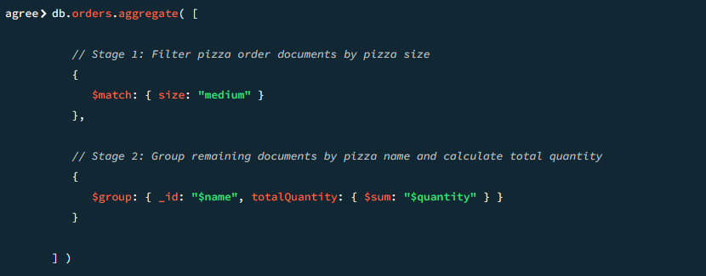
Aggregate syntax

Slide 5
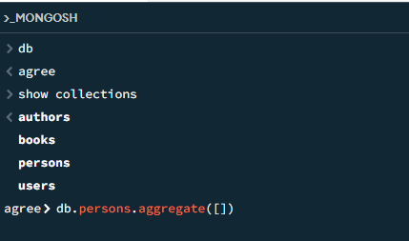
Aggregate Continue…

Slide 6
Aggregate Stage
A stage can filter documents, group documents, and calculate values.
The documents that are output from a stage are passed to the next stage.

Slide 7
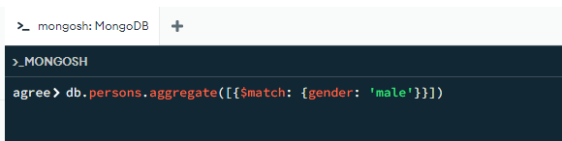
I Stage

Slide 8
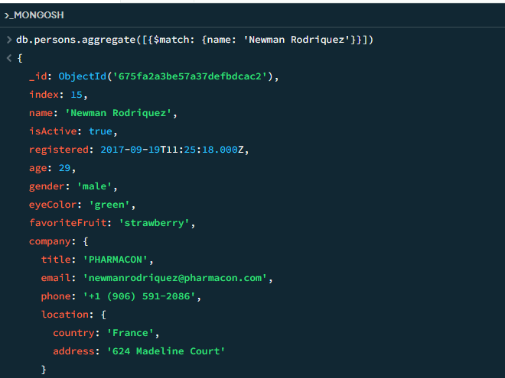

Slide 9
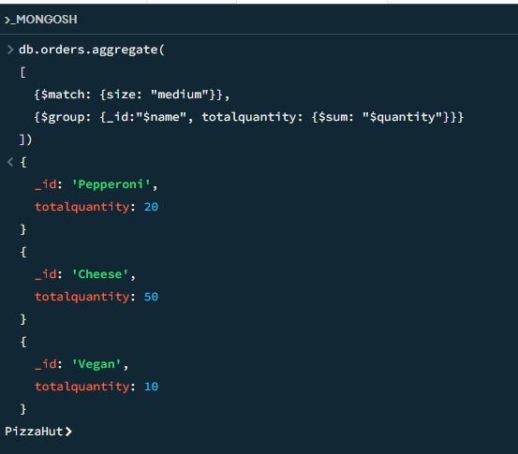
2 Stages

Slide 10
For more details
https://www.mongodb.com/docs/manual/core/aggregation-pipeline/

Slide 11
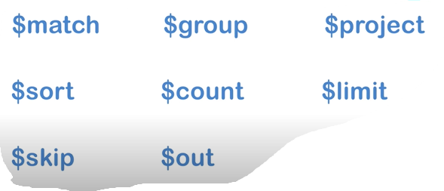
Stage Operators

Slide 12
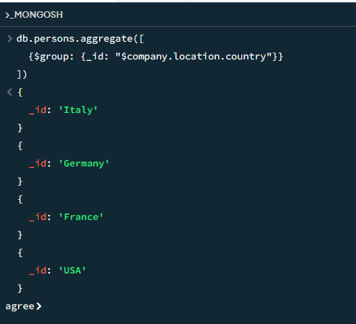
Aggregation Expression

Slide 13
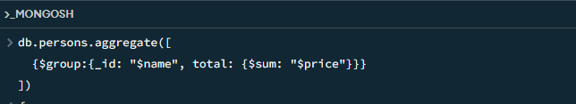
Aggregate Expression

Slide 14
$match
Match specific document using query
{match: {<query>}

Slide 15
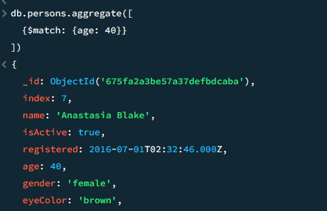
$match Example

Slide 16
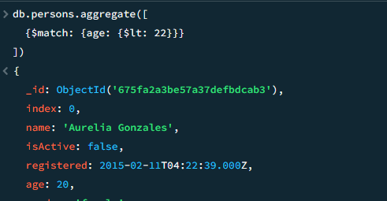
$match continue

Slide 17
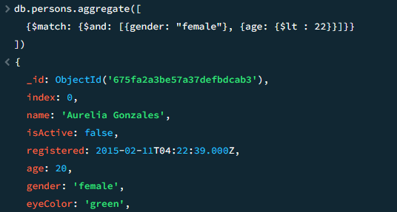
$match continue

Slide 18
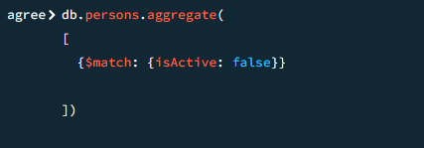
Query Boolean Data

Slide 19
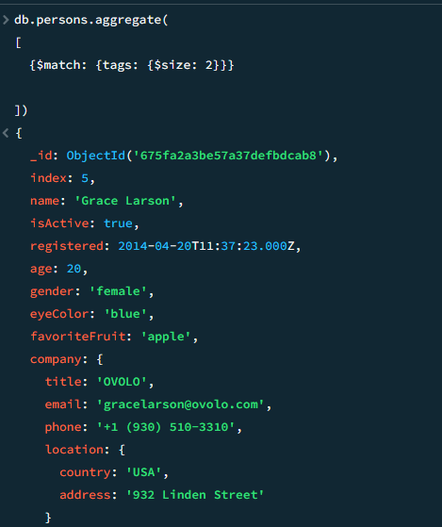
Query Size

Slide 20
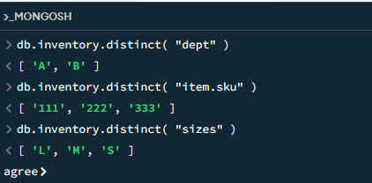
Distinct

Slide 21
Question(s)

